Slide 1
PROJECTS
AWS ESSENTIALS
BATCH 1

Slide 2
PROJECT 1
EC2- CREATING AND MANAGING WINDOWS MACHINE

Slide 3
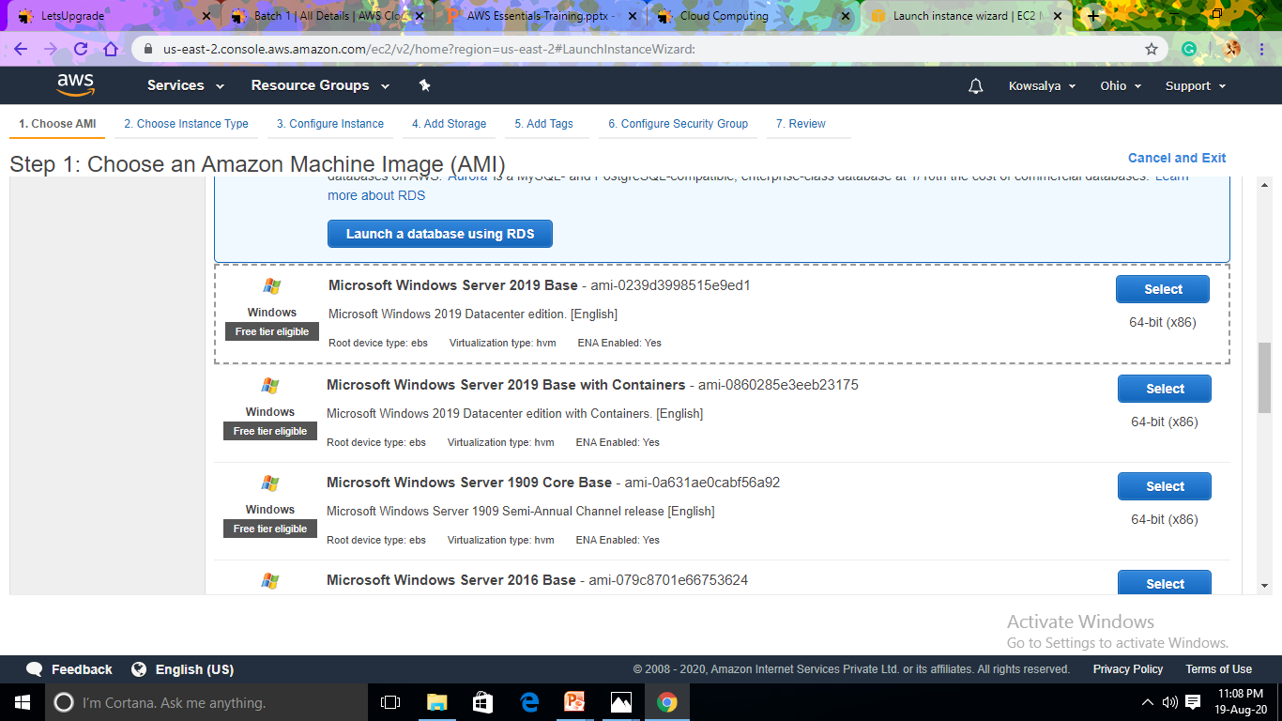
Create a Windows Instance Using AMI: MS Windows Server 2019 Base

Slide 4
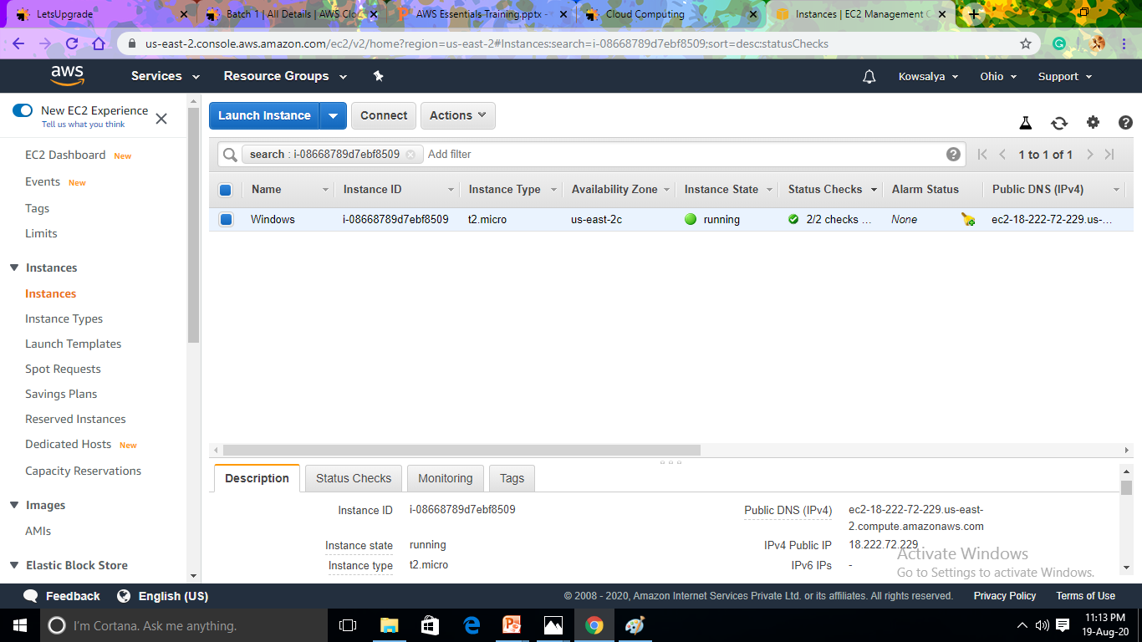
Launch the Windows Instance

Slide 5
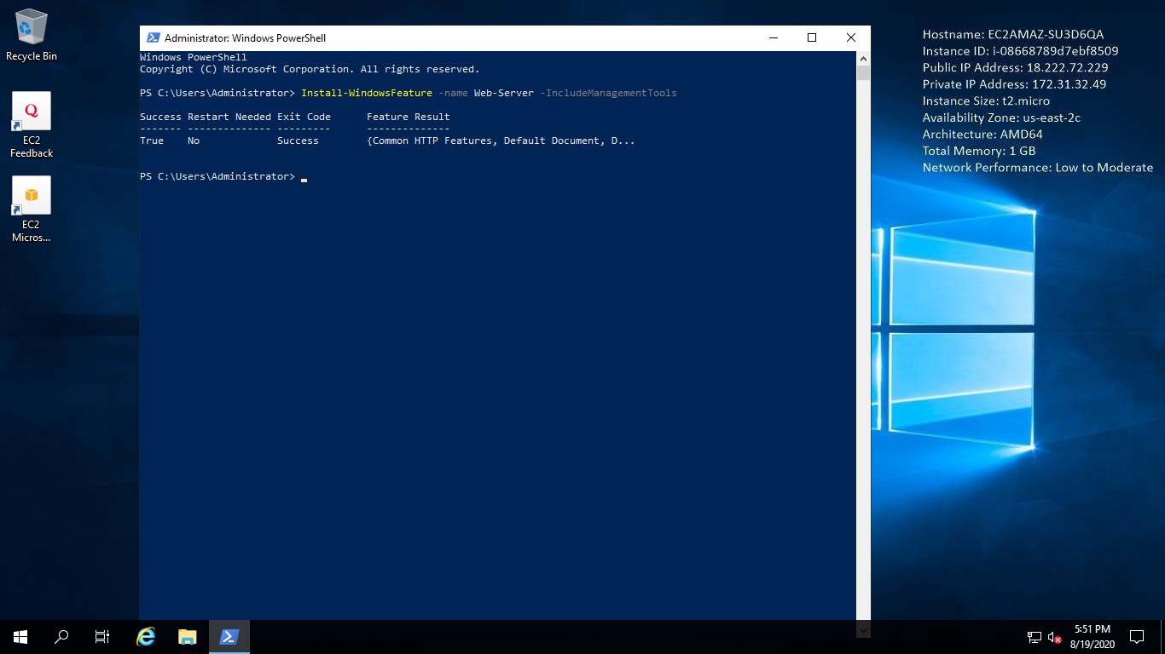
Install IIS Web Server Using PowerShell ISE

Slide 6
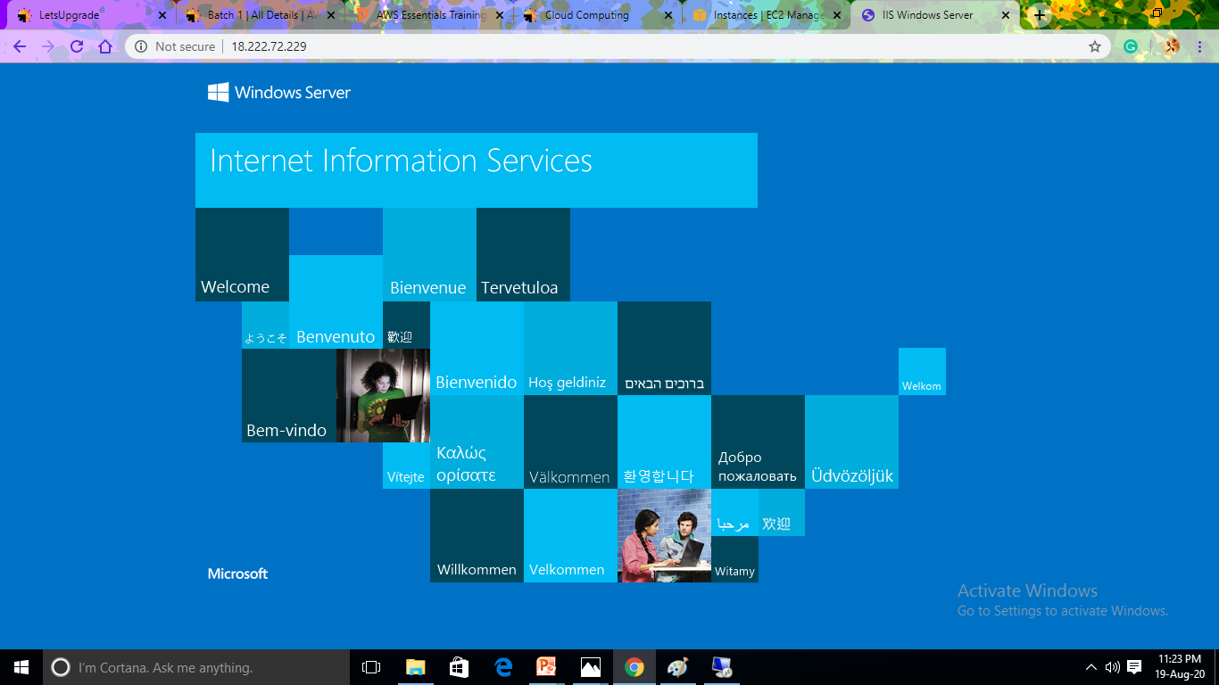
Verify the Installation of IIS Web Server

Slide 7
PROJECT 2
EC2- CREATING AND MANAGING UBUNTU MACHINE

Slide 8
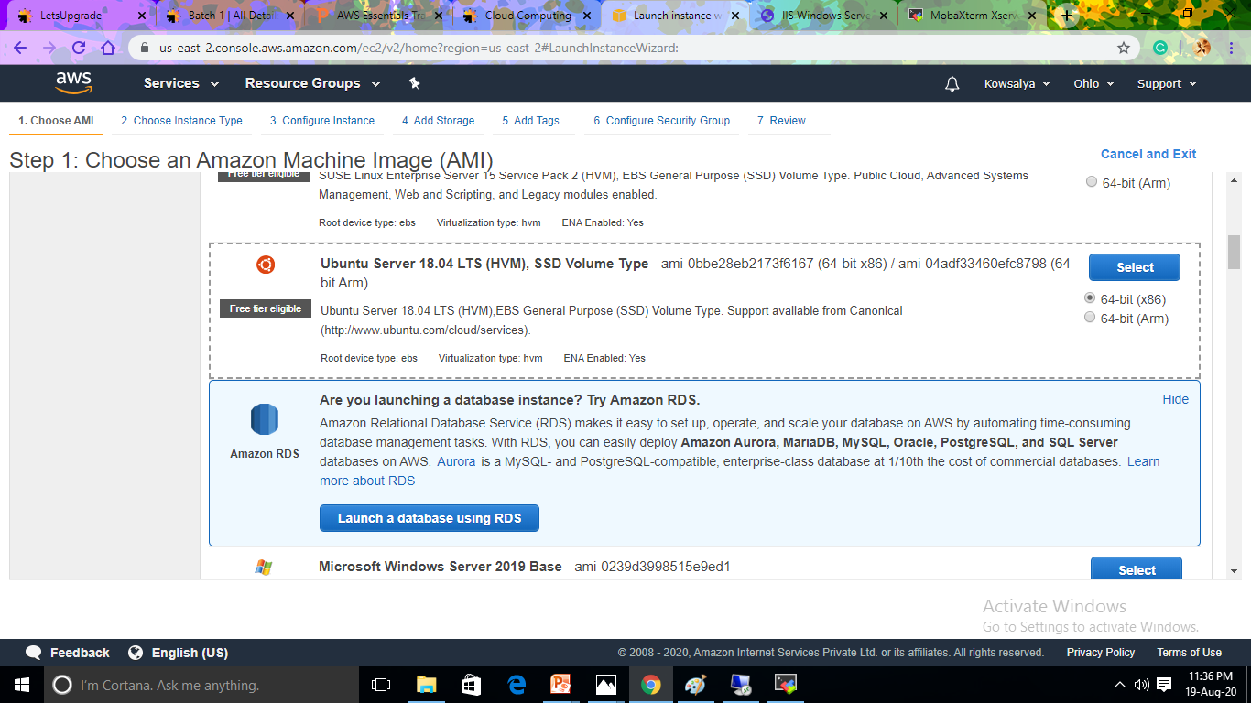
Create a Instance Using AMI: Ubuntu Server 18.04 LTS (HVM)

Slide 9
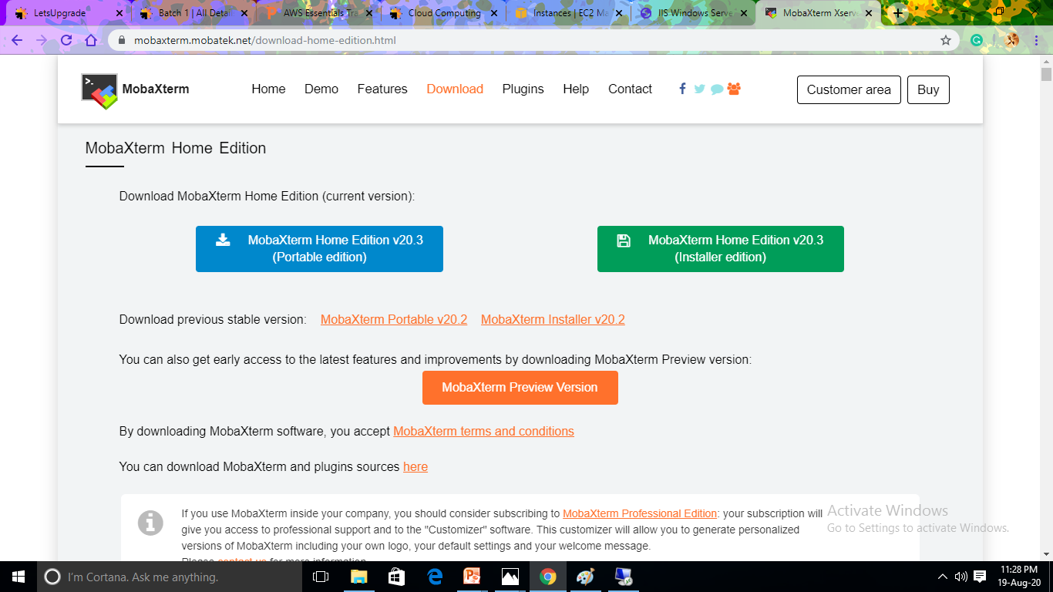
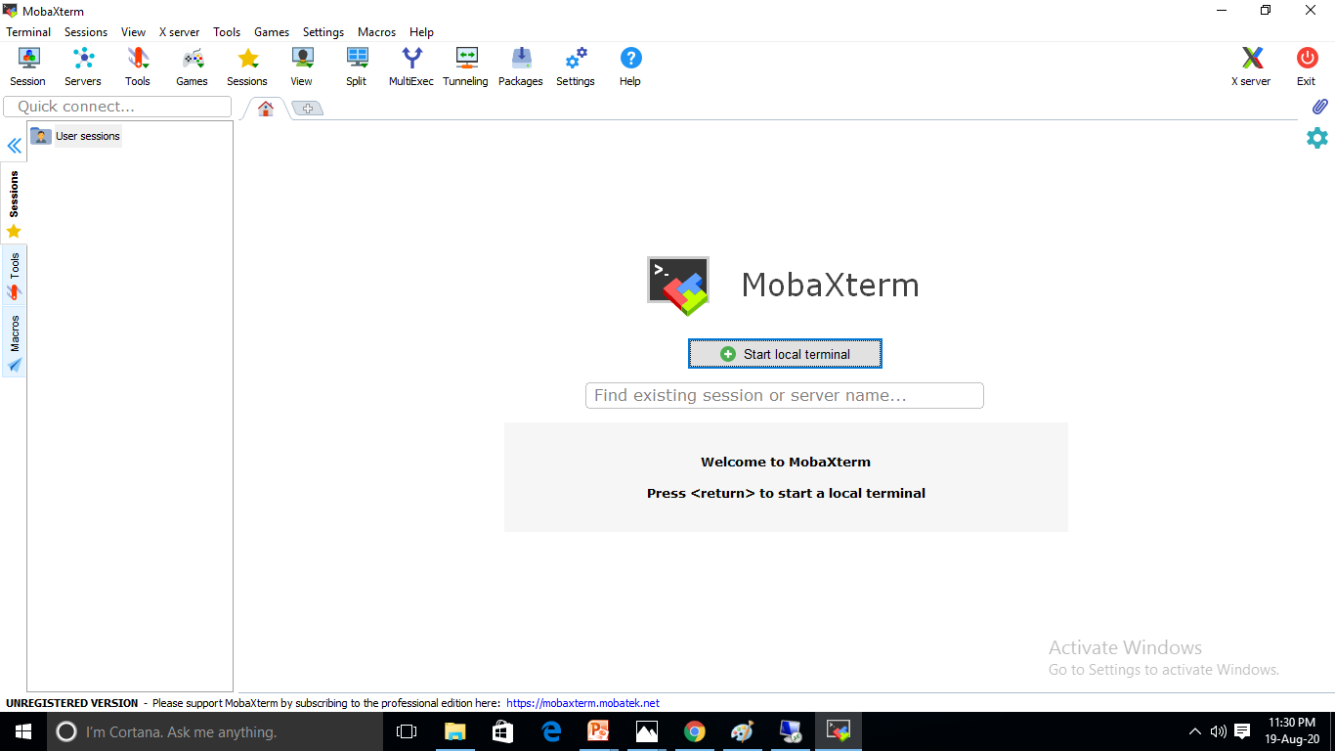
Download and Install MobaXterm Portable Edition

Slide 10
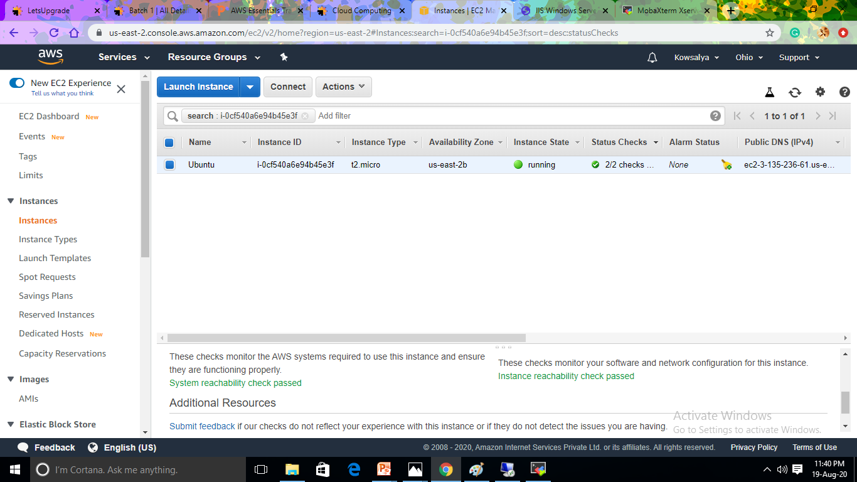
Launch the Ubuntu Instance Using SSH

Slide 11
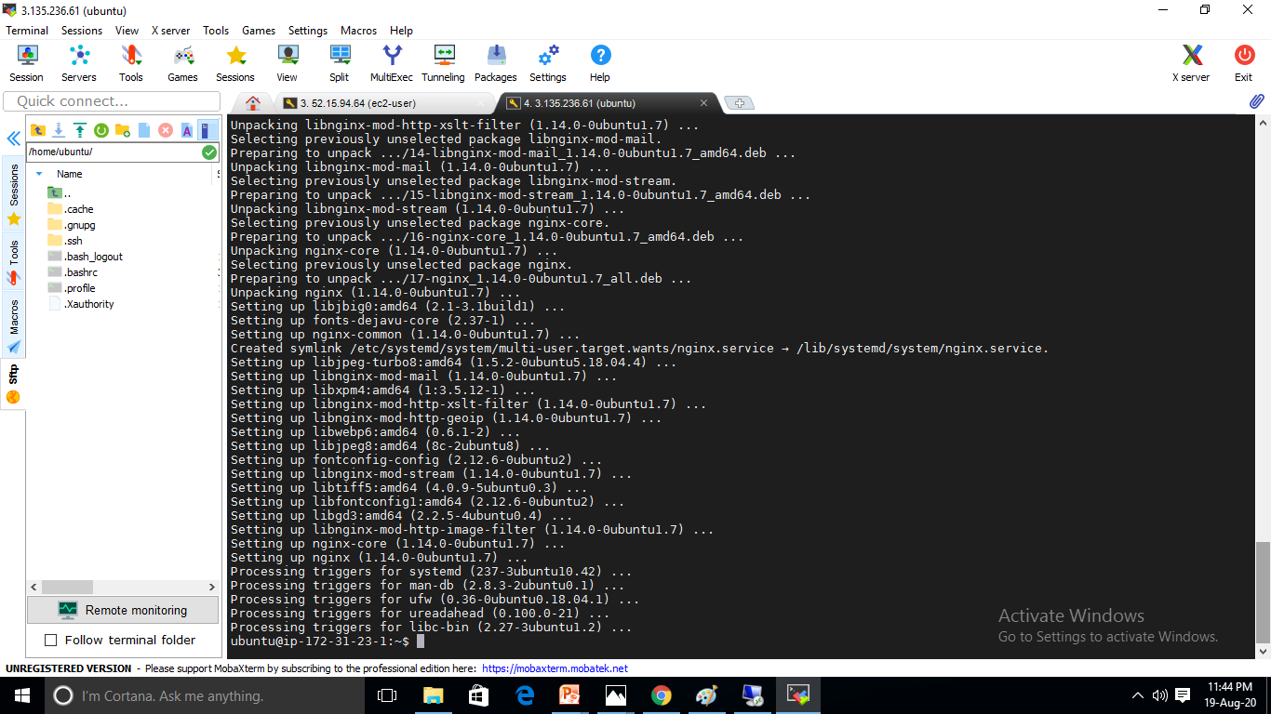
Install nginx Web Server Using Bash

Slide 12
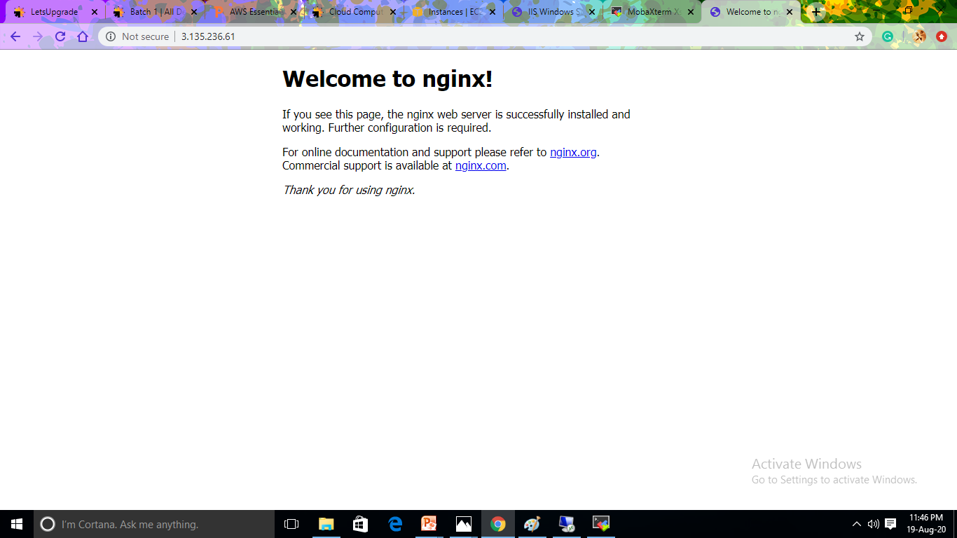
Verify the Intallation of nginx

Slide 13
Thank You

